Slide 1

生物信息学顶级期刊 Bioinformatics
An Attention-based BiLSTM-CRF Approach to Document-level Chemical Named Entity Recognition
Ling Luo, Zhihao Yang, Pei Yang, Yin Zhang, Lei Wang, Hongfei Lin and Jian Wang
¹Dalian University of Technology
²Beijing Institute of Health Administration and Medical Information
Notes:
Availability: Data and code are available at https://github.com/lingluodlut/Att-ChemdNER.

Slide 2
摘要
目前主流的 chemical 实体识别方法大多是基于传统的机器学习方法，它们的表现依赖于人工特征工程。而且这些方法主要是句子级别的方法，同一篇文档不同句子中的相同实体往往被标注成不同的标签，存在实体标注非一致性的问题。
1

Slide 3
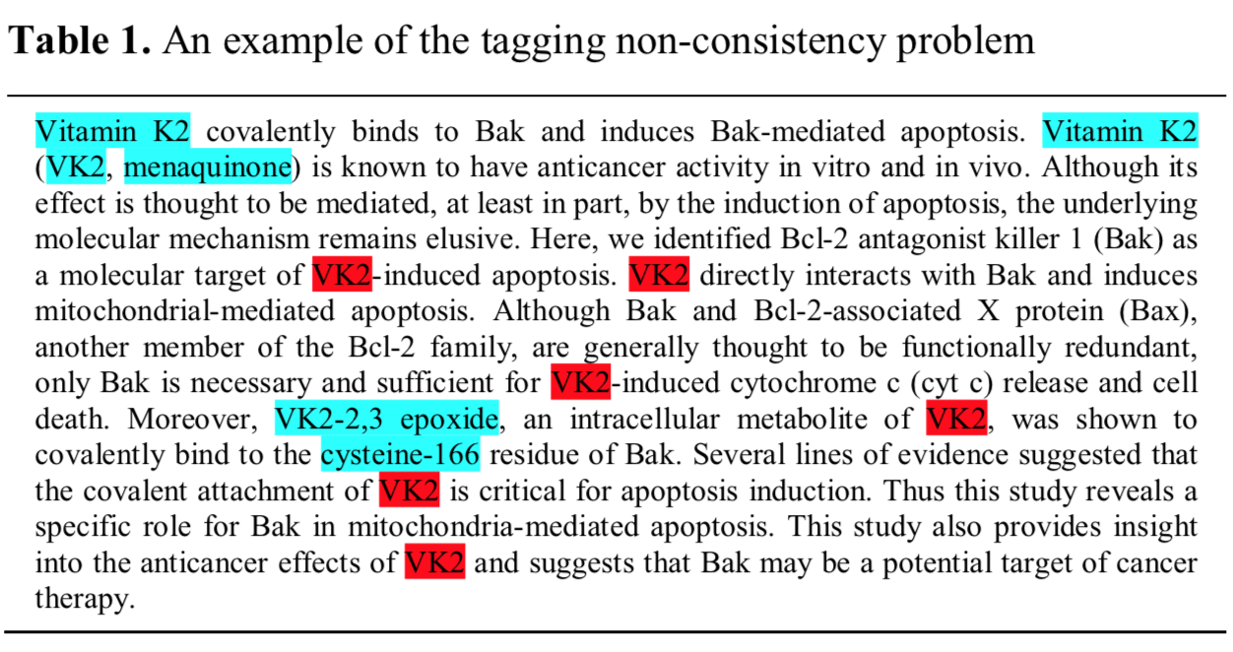
实体标注非一致性
1

Slide 4
摘要
针对这些问题，本文提出了一种基于注意力机制的神经网络方法（Att-BiLSTM-CRF）来进行文档级别的 chemical 实体识别，提高文档内实体标注的一致性
在国际技术评测BioCreative IV CHEMDNER数据集和BioCreative V CDR数据集上分别取得了91.14%和92.57%的F值，优于其它现有的方法。
1

Slide 5
Chemical NER challenge
多种命名方式
various ways of naming chemical
缩写造成歧义
ambiguities caused by the frequent occurrences of abbreviations and acronyms
新的实体连续不断的出现
new chemical constantly and rapidly reported in scientific publications
含有特殊字符等符号
and a number of symbols mixed with common words (Liu et al., 2015).
1

Slide 6
Previous works for biomedical entities identify
CRF-based
depend on effective feature engineering
deep learning
  genes and proteins (Li et al., 2015)
  diseases (Sahu and Anand, 2016)
  chemicals (Chalapathy et al., 2016)
  BiLSTM-CRF (Huang et al., 2015; Lample et al., 2016).
1

Slide 7
Deficiency
Both the above-mentioned standard traditional machine learning methods and deep learning methods in practice treat NER as a sentence-level task
these sentence-level NER methods lead to the tagging non-consistency problem
  the rule-based post-processing step to enforce tagging consistency
  noise
1

Slide 8
Contribution
Att-BiLSTM-CRF approach
A novel attention mechanism to capture similar entity attention at the document-level.
Domain features used in traditional NER methods are investigated
1

Slide 9
Methods
Embedded features
Basic BiLSTM-CRF model
Proposed Att-BiLSTM-CRF model
1

Slide 10
Features
Word embeddings
  Downloaded 1,918,662 MEDLINE abstracts from the PubMed website with the query string “chemical” + CHEMDNER corpus
  skip-gram model
Character embeddings
  initialized randomly
  BiLSTM (Concatenation)
  learned while training
Additional Features
  generated by the GENIA tagger
  (http://www.nactem.ac.uk/GENIA/tagger/).
1

Slide 11
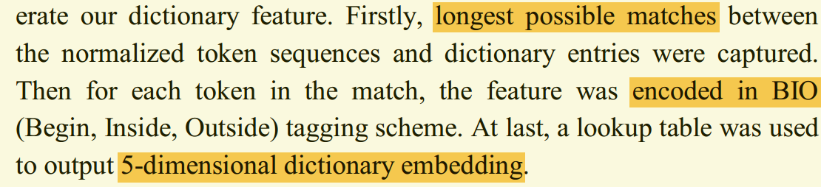
Additional features
25-dimensional POS embedding
10-dimensional chunking embedding
5-dimensional dictionary embedding
资源
  GENIA tagger (http://www.nactem.ac.uk/GENIA/tagger/)
  Jochem dictionary (Hettne et al., 2009)
  CTD (Davis et al., 2009)
1

Slide 12
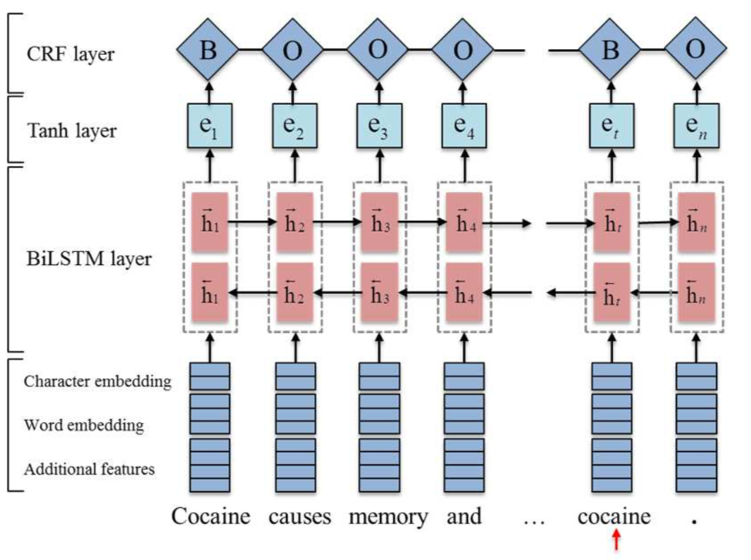
BiLSTM-CRF model
1

Slide 13


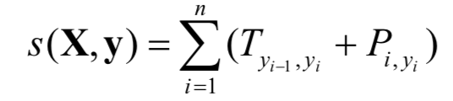
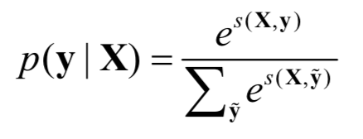
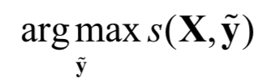
BiLSTM-CRF model
前向/反向LSTM的每个时间步隐层拼接
Tanh 层
线性链CRF，计算可能路径得分
T 是转移矩阵，P 是状态矩阵
Softmax得到预测路径的条件概率，
归一化得分
选择最佳预测路径
1

Slide 14
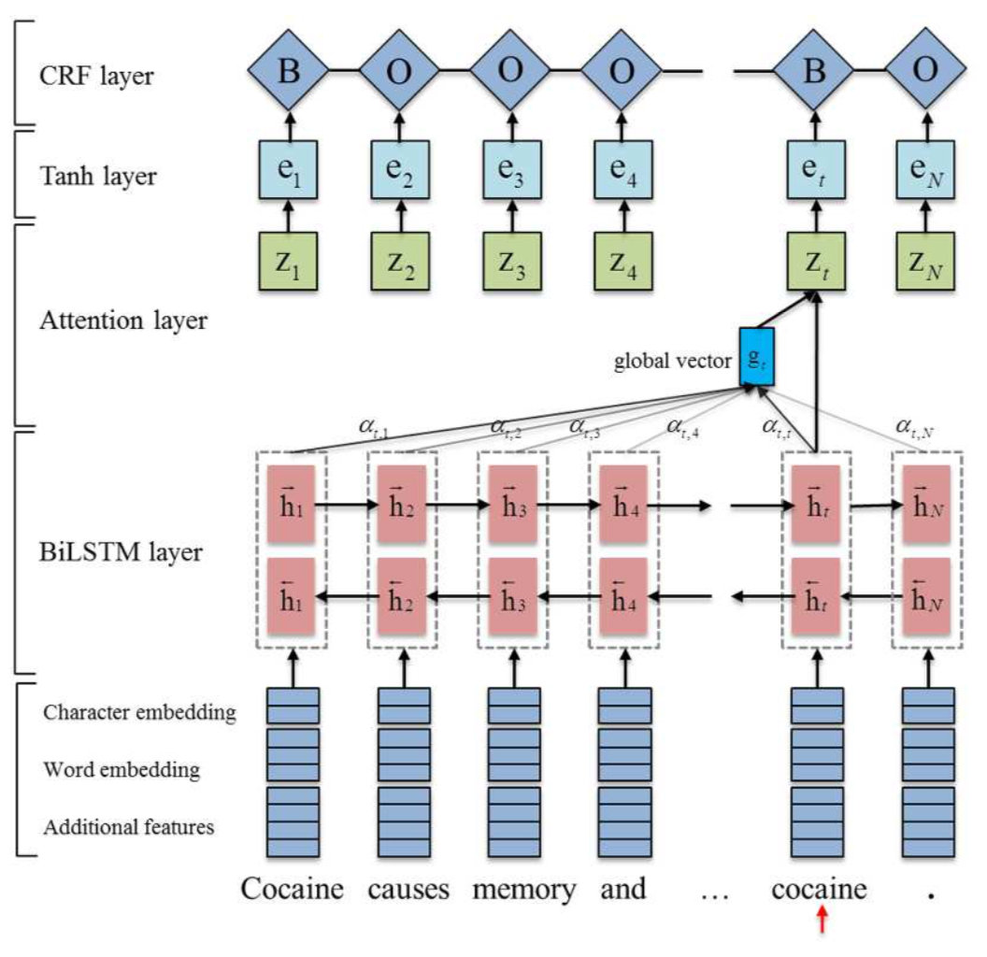
Att-BiLSTM-CRF model
1

Slide 15


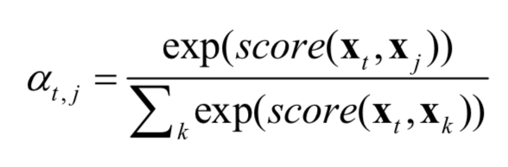
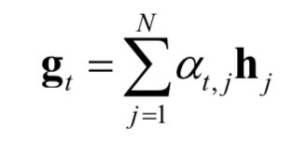

Att-BiLSTM-CRF model
文档，包含m个句子X
句子，包含n个单词
the t^{th} current target
word representation x_{t}
加权和
Attention层输出
残差拼接 + tanh 激活
1

Slide 16
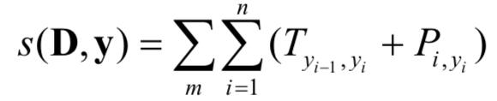
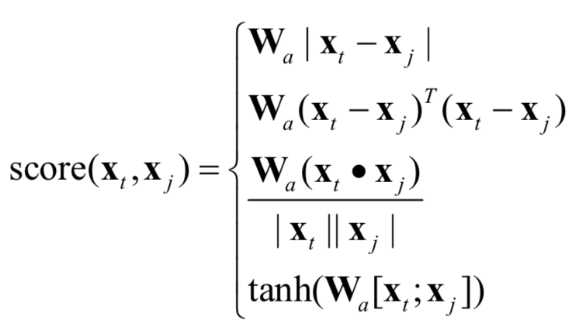
Att-BiLSTM-CRF model
针对输入的文档D进行
文档级CRF解码
4种score函数的变体：
1.manhattan distance
2.euclildean distance
3.cosine distance
4.perceptron
1

Slide 17
Datasets
CHEMDNER
  the BioCreative IV chemical compound and drug name recognition (CHEMDNER) corpus
CDR
  the BioCreative V chemical-disease relation (CDR) task corpus
  the annotated chemicals (a total of 15,933 chemical entity mentions) were used in our experiments.
10% validation
1

Slide 18
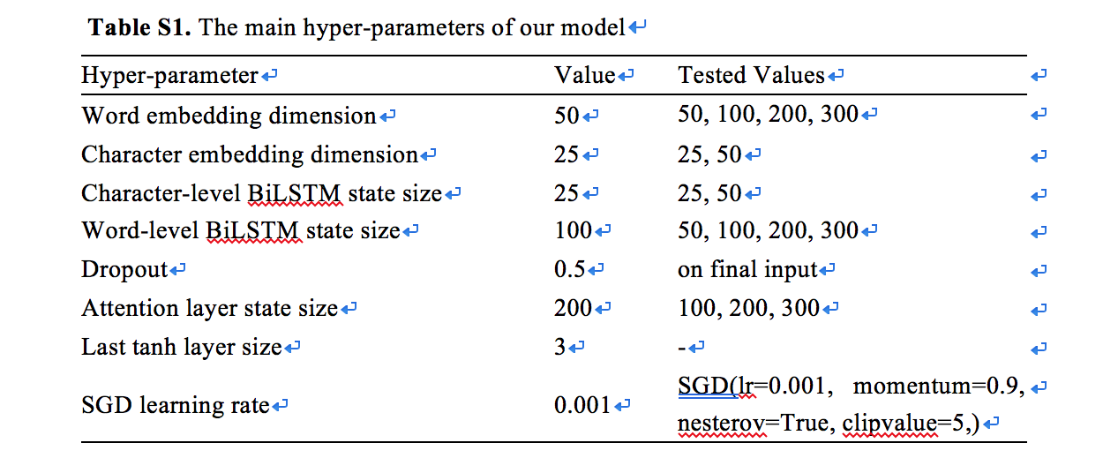
Settings
1

Slide 19
Settings
Decay=True
Epochs=40
Batch_size=5
Shuffle=True
EarlyStopping(patience=15,mode='min')
1

Slide 20
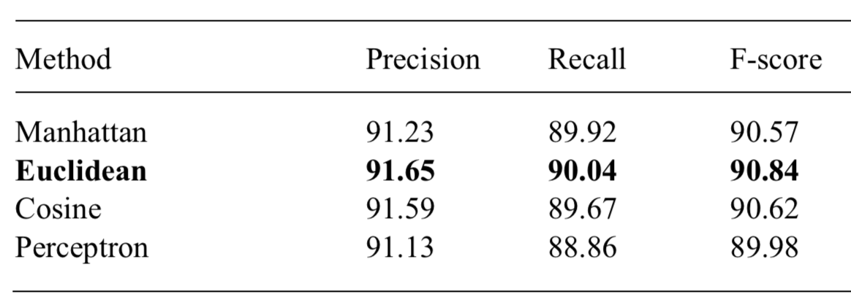
Alignment functions
1

Slide 21
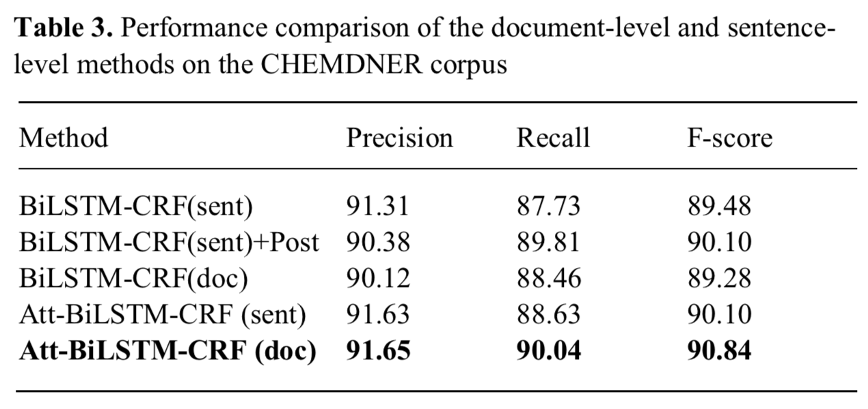
document-level vs. sentence-level
1

Slide 22
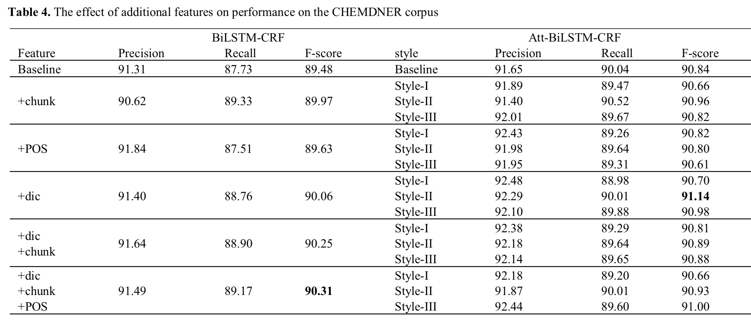
The effect of additional features
1

Slide 23
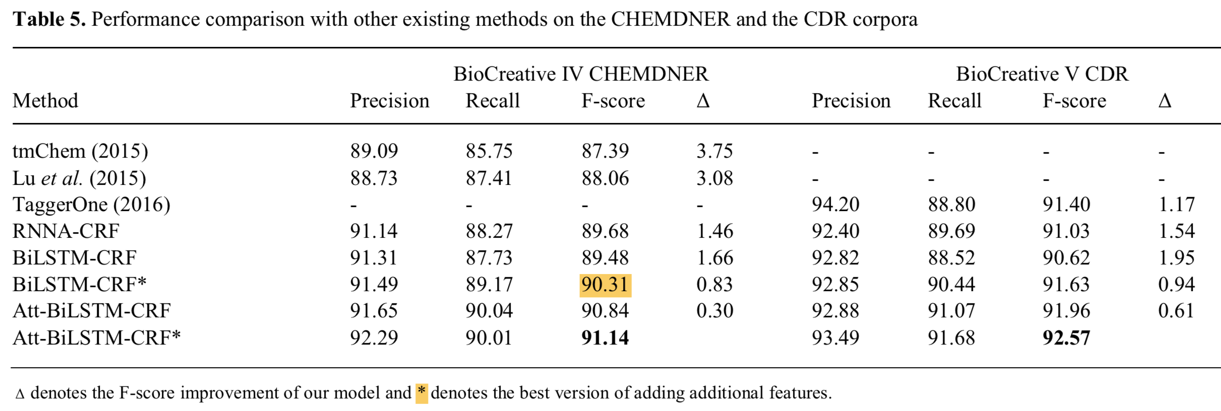
Comparison with other methods
1

Slide 24
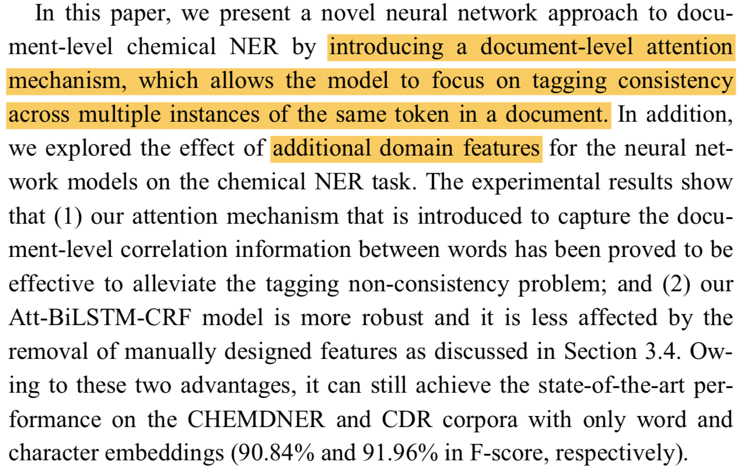
Conclusions
1

Slide 25
Future work
标注一致性依赖弱的NER问题
长距离依赖问题，abstract→article
1

Slide 26
Thank you
Notes:
That’s all, thank you for your attention.

